Slide 1
BlinkIT Grocery Sales Analysis Dashboard
POWER BI
M V GANESH

Slide 2
STEP 1
The dataset contains grocery sales information such as:
Item Type
Item Fat Content
Outlet Size
Outlet Location Type
Outlet Type
Outlet Establishment Year
Sales
Rating

Slide 3
STEP2
The objective of this project is to analyze BlinkIT grocery sales data and create an interactive dashboard to understand:
Total sales
Average sales
Outlet performance
Item type performance
Sales by outlet size and location

Slide 4
STEP3 Data Cleaning
In Power Query, I performed:
Checked missing values
Removed duplicate records
Corrected data types
Standardized text values
Removed unnecessary columns if required

Slide 5
STEP4 Data Transformation
I transformed the data to make it analysis-ready:
Cleaned item fat content values
Checked numerical columns
Verified sales and rating columns
Prepared data for dashboard visuals

Slide 6
STEP 5 DAX Measures Created
I created measures like:
Total Sales = SUM('BlinkIT Grocery Data'[Sales])
Average Sales = AVERAGE('BlinkIT Grocery Data'[Sales])
No of Items = COUNT('BlinkIT Grocery Data'[Item Identifier])
Average Rating = AVERAGE('BlinkIT Grocery Data'[Rating])

Slide 7
DASHBOARD
Card Visuals → Total Sales, Average Sales, Number of Items, Average Rating
Area Chart → Total Sales by Outlet Establishment Year
Funnel Chart → Total Sales by Outlet Location Type
Donut Chart → Fat Content Analysis
Clustered Bar Chart → Item Fat Content by Outlet Location Type
Horizontal Bar Chart → Item Type Analysis
Pie Chart → Total Sales by Outlet Size
Table Visual → Outlet Type Analysis

Slide 8
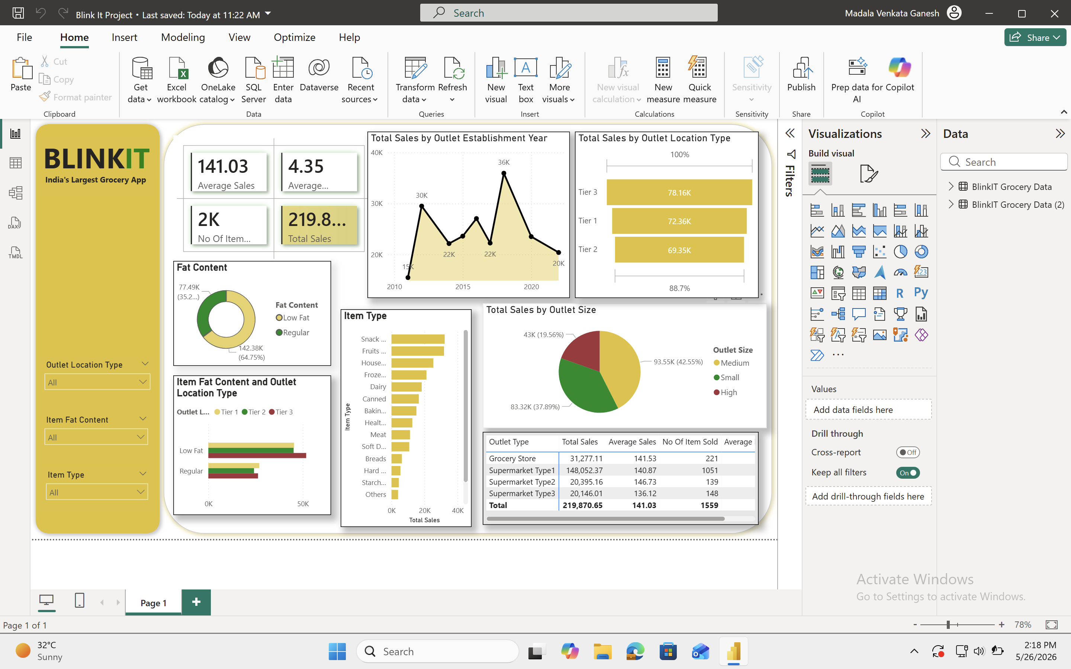

Slide 9
KEY INSIGHTS
Main findings:
Tier 3 locations had the Lowest sales.
Medium outlets contributed the most revenue.
Supermarket Type 1 performed best.
Snack foods were among the top-selling categories.
Low Fat items had higher sales contribution.

Slide 10
BUSINESS RECOMMENDATIONS
Focus more on Tier 3 locations.
Increase stock of high-selling item categories.
Improve sales strategy for low-performing outlet types.
Use outlet-size analysis for better expansion planning.
This dashboard helps BlinkIT understand sales performance across products and outlets. It supports better decision-making by identifying top-performing locations, outlet types, and product categories.

Slide 11
THANK YOU

